Slide 1
Genetic Disease Diagnosis using Machine learning and Facial Photos

Slide 2
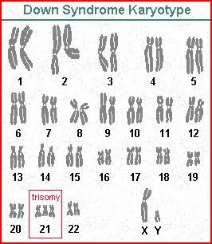
Down Syndrome
Down syndrome is a condition in which a person has an extra chromosome. Chromosomes are small “packages” of genes in the body. They determine how a baby’s body forms during pregnancy and how the baby’s body functions as it grows in the womb and after birth. Typically, a baby is born with 46 chromosomes. Babies with Down syndrome have an extra copy of one of these chromosomes, chromosome 21. A medical term for having an extra copy of a chromosome is ‘trisomy.’ Down syndrome is also referred to as Trisomy 21. This extra copy changes how the baby’s body and brain develop, which can cause both mental and physical challenges for the baby.

Slide 3
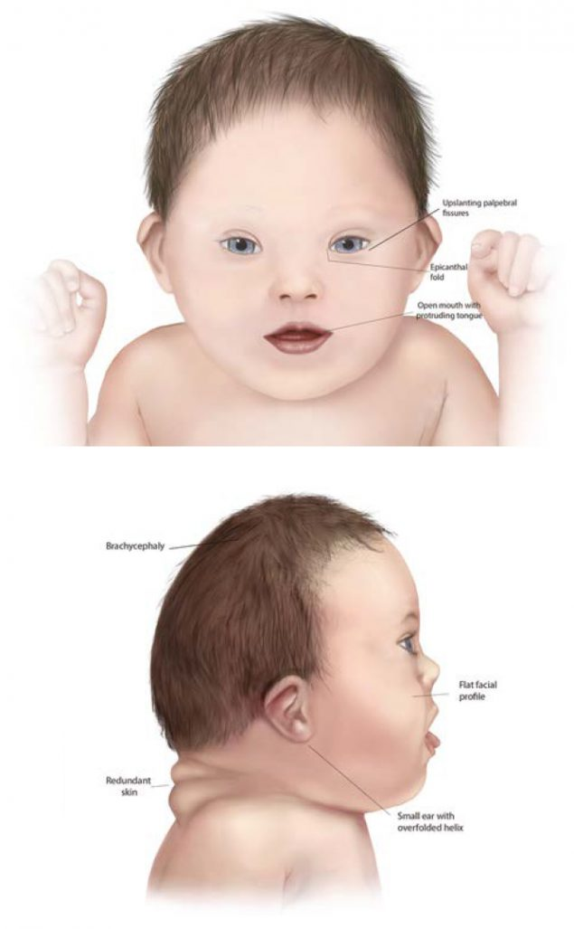
common physical facial features of Down syndrome
A flattened face, especially the bridge of the nose
Almond-shaped eyes that slant up
A short neck
Small ears
A tongue that tends to stick out of the mouth
Tiny white spots on the iris (colored part) of the eye

Slide 4
Our Data collection
152 Photo
Of down syndrome with different ages
125 Photo
Of Normal people with different ages
They are catigorized to
200Train
60 Test
Quotes for illustration purposes only

Slide 5
Sources we used to get our data collection:

Slide 6
We built a database of publically available or scientifically published pictures of patients collected across the internet.
Datasets from papers like :
Diagnostically relevant facial gestalt information from ordinary photos
Down Syndrome Detection from Facial Photographs using Machine Learning Techniques
Down Syndrome Detection Using Modified AdaBoost Algorithm
other:
London Medical Databases Library
Gettyimages
Facial age/ Kaggle

